Slide 1
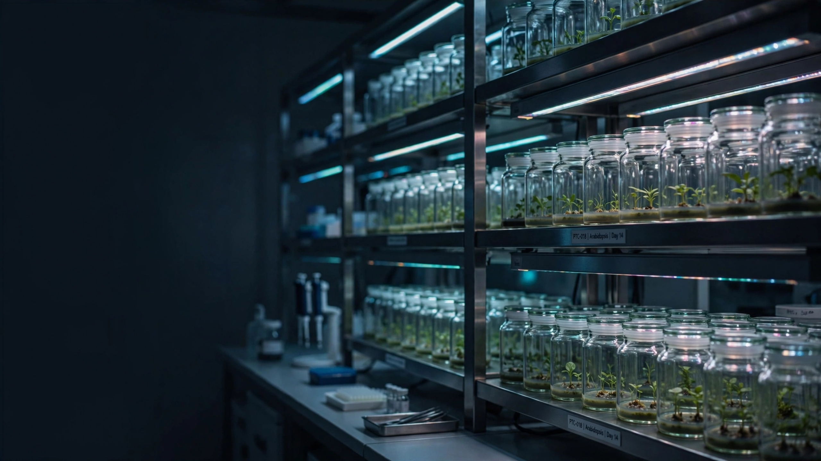


Digital Transformation for Micropropagation
Lab to Greenhouse:
Intelligent Plant Tissue Culture Management System

Slide 2
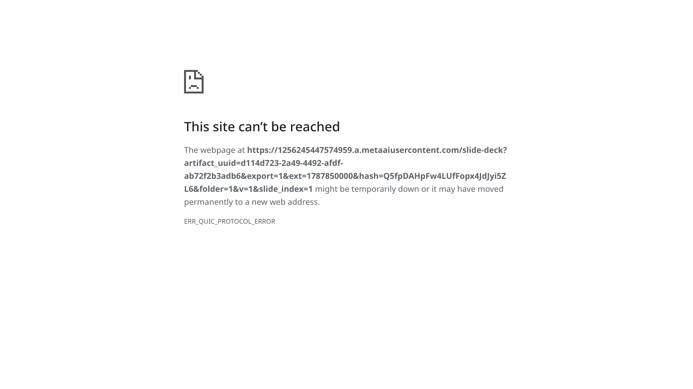

Slide 3


Slide 4


Slide 5


Slide 6


Slide 7


Slide 8


Slide 9


Slide 10


Slide 11


Slide 12


